Slide 1
Charts – Simple
PrintNet T

Slide 2
Context Schema
Workflow
Data Input
&
Manipulation
Document
Design
(Layout)‏
Impositioning
Approval (Proof)‏
Spool Production

Slide 3

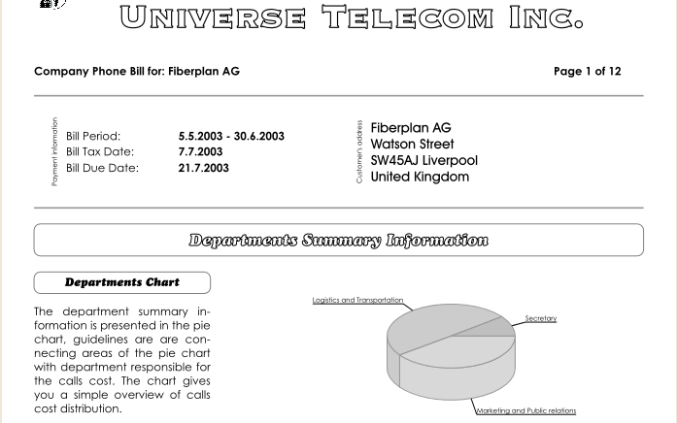
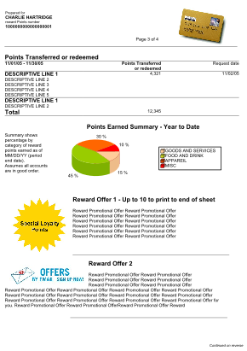

Charts – Introduction
Charts are another great way of presenting data.

Slide 4
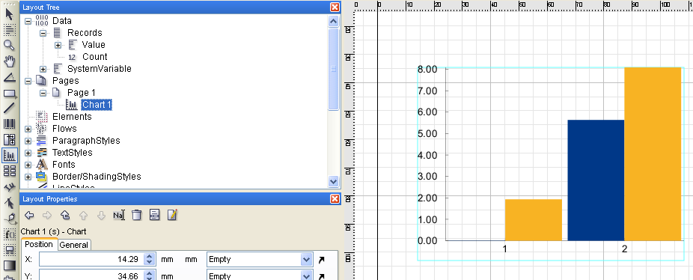
Charts – Setup
No flow area needed to create a chart.
Simply select the Chart tool from the toolbar and drag and drop.

Slide 5
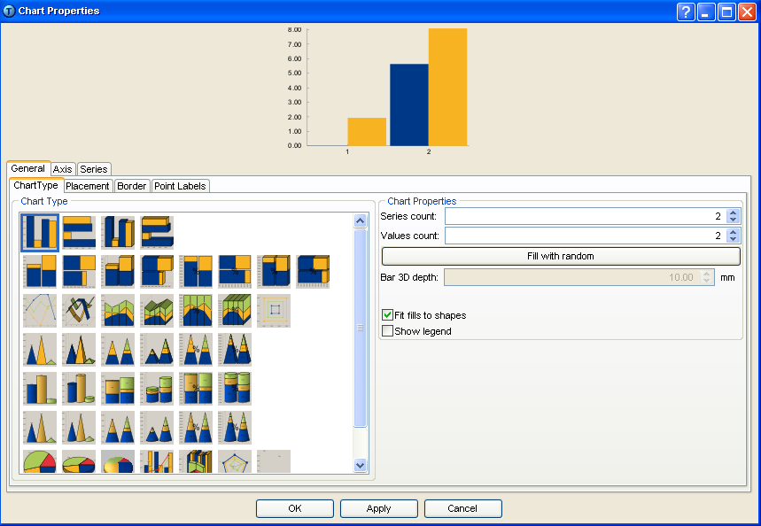
Chart Properties
Double-click on the chart to open Chart Properties.
Chart preview
Selection tabs
Notes:
There are many options in charts – too many to mention in this presentation. In fact, many options change depending on the type of chart you select. A few features will be mentioned in this presentation, but it is recommended that you familiarize yourself with PrintNet T’s very extensive Help menu to learn more about charts. Don’t be afraid to experiment too; you can always remove any changes to charts that you don’t like.
Selection tabs will differ according to the chart type selected.

Slide 6
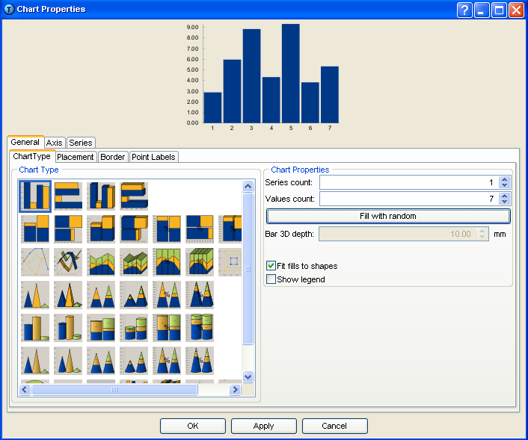
Chart Properties
General tab:
  Select chart type; select number of series and values.
Select series and value count
Choose chart type
Notes:
Chart Type – PrintNet T supports a wide variety of different charts: line charts, pie charts, bar charts, 3D charts, etc.
Series and Value count – Simple charts generally have just one series (though they can have more); values are the more familiar measurements that are compared in a chart.
For example, you want to create a chart that shows Company A’s expenditures for, say, the month of March: if there are seven categories of expenditure (wages, office supplies, utility bills, raw materials, transportation, property taxes or rent, and equipment purchases), then that means there will be seven values in your chart. If you wan to create a chart that compares Company A’s expenditures (same categories) for March AND April, then your chart will still have seven values, but now it will have two series (March and April).

Slide 7
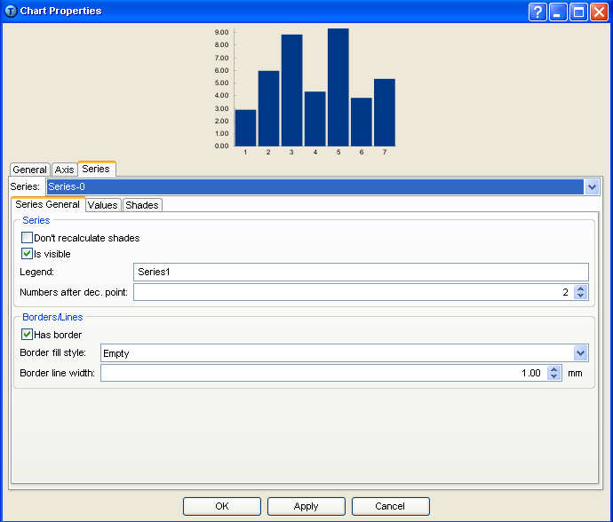
Chart Properties
Series tab:
  Select the series you want to define.
Series selector
Notes:
The series selector is very important; make sure that before you begin working on the values tab, the correct series is selected (this will save a lot of trouble later!).

Slide 8
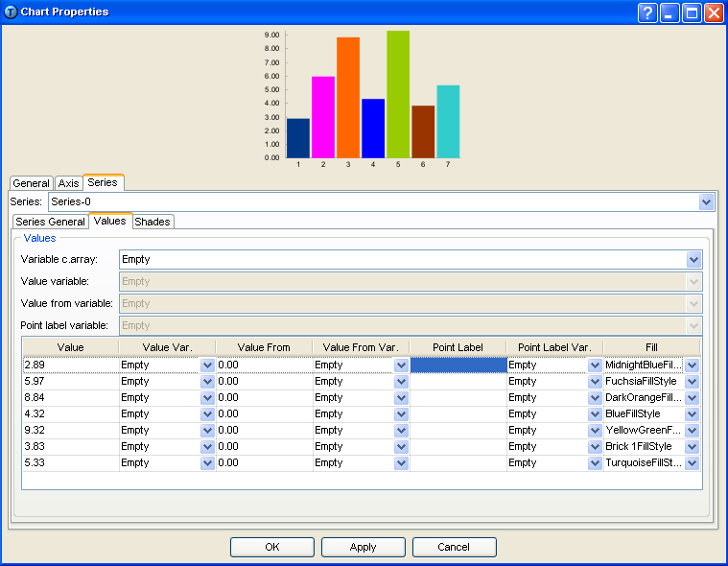
Chart Properties
Series tab:
  Change the color of values
Notes:
Especially if you are creating a chart with two or more series which use the same values, it might be a good idea to use colors to represent the values – this will make comparison of series easier.

Slide 9
Chart Properties
Series tab:
  Input values
Fixed values

Slide 10
Chart Properties
Series tab:
  Input values
Variable values
Notes:
Note: Data must be in a calculable format (i.e., Double, Int, Int64, or Currency) to be a chart value variable.
Use this method of variable value input if the number of values in chart will remain fixed each time.

Slide 11
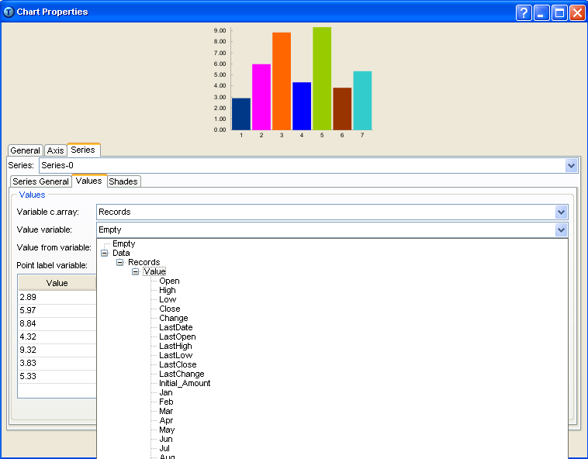
Chart Properties
Series tab:
  Input values
Variable values
Notes:
Note: Data must be in a calculable format (i.e., Double, Int, Int64, or Currency) to be a chart value variable.
Use this method of variable value input if the number of values in chart will be variable each time (this method is more ‘global’).

Slide 12
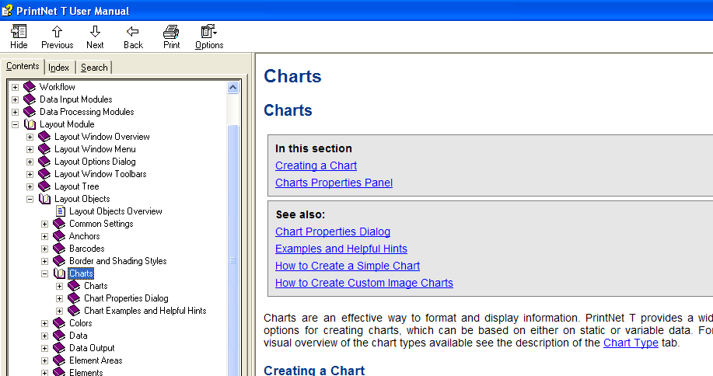
Charts – Q & A
There is a very extensive collection of information about charts in the PrintNet T User Manual: Help | User Manual or <F1>.

Slide 13

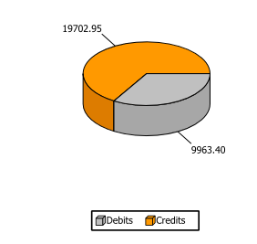

Simple Chart – Exercise
Create a simple chart with variable values.
  Open ChartExercise.wfd.
  In Layout, create a new Element (90 x 90); insert a chart in the Element.
  Open the ContPage node, and insert the Chart Element in AccountStatementFlow, underneath the table.
  Set your chart to look like this:
  Use pie chart (1 series, 2 values)‏
  AbsoluteTotalDebit, TotalCredit are value variables
  Show point labels and guidelines
  Show legend
  Show value borders
  Colors: OrangeFill, LightGreyFill
  Need Help? Press <F1> to open the User Manual
Notes:
Check ChartExercise_Done.wfd for exercise resolution.
If you have trouble, the PrintNet T User Manual is extremely helpful; press <F1>, or click on Help | User Manual to open and use the User Manual.

Slide 14

Charts – Summary
In this presentation we have learned:
  The difference between series and values
  How to:
    Create a simple chart
    Input fixed chart values
    Input variable chart values

Slide 15

Charts – Discussion
What kinds of chart can you make with PrintNet T?
What is the difference between series and values?
Notes:
What kinds of chart can you make with PrintNet T?
Bar charts, line charts, cone charts, cylinder charts, pyramid charts, pie charts (2D or 3D; stack charts).
What is the difference between series and values?
Values are what is actually being measured and/or compared in the chart; series are the holder or definer of the values – it gives parameters within which values must be measured.

Slide 16

Thank You.
Do You Have Any Questions?

